Slide 1
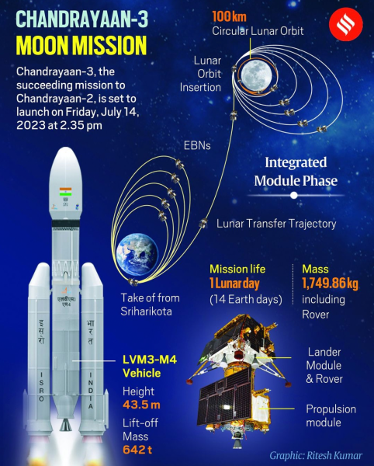

Success Meet
on
Chandrayaan-3
Date: August 24th 2023
MVN, JS & RVR College of Arts and Science Malikipuram
Dr.B.R.Ambedkar Konaseema Dt. 533253 A.P.
Organised by
Departments of Physics & Elecronics

